Slide 1
Python

Slide 2
Files
Traditional definition: A computer file is a resource for storing information, which is available to a computer program and is usually based on some kind of durable storage
In Python, these files can be accessed using the file object discussed in the next few slides
File objects can be used to access not only normal disk files, but also any other type of "file" that uses that abstraction
Notes:
Devices are accessed as files in linux. (confirm it)

Slide 3
Opening a File
To open a file use the open() or file() functions
Syntax:
file_object = open(file_name [, access_mode][, buffering])
file_name: The file_name argument is a string value that contains the name of the file that you want to access.
access_mode: The access_mode determines the mode in which the file has to be opened, i.e., read, write, append, etc.
buffering: If the buffering value is set to 0, no buffering takes place. If the buffering value is 1, line buffering is performed while accessing a file. If you specify the buffering value as an integer greater than 1, then buffering action is performed with the indicated buffer size. If negative, the buffer size is the system default (default behavior).

Slide 4
Closing a File
The close() method of a file object flushes any unwritten information and closes the file object, after which no more writing can be done
Python automatically closes a file when the reference object of a file is reassigned to another file
It is a good practice to use the close() method to close a file
Syntax:
file_object.close()

Slide 5
Built-in Methods: Input
The read() method is used to read bytes directly into a string, reading at most the number of bytes indicated
Syntax: file_object.read([size])
The readline() method reads one line of the open file (reads all bytes until a line-terminating character like NEWLINE is encountered)
Syntax: file_object.readline([size])
The readlines() reads all (remaining) lines and returns them as a list of strings
Syntax: file_object.readlines([sizeint])
Notes:
Reads at most size bytes from the file (less if the read hits EOF before obtaining size bytes).
Reads one entire line from the file. A trailing newline character is kept in the string. Like read(), there is also an optional size option, which, if not provided, defaults to -1, meaning read until the line-ending characters (or EOF) are found. If present, it is possible that an incomplete line is returned if it exceeds size bytes.
Reads until EOF using readline() and return a list containing the lines. If the optional sizehint argument is present, instead of reading up to EOF, whole lines totalling approximately sizehint bytes (possibly after rounding up to an internal buffer size) are read.

Slide 6
Built-in Methods: Output
The write() takes a string that can consist of one or more lines of text data or a block of bytes and writes the data to the file
Syntax: file_object.write(str)
The writelines() takes a string that can consist of one or more lines of text data or a block of bytes and writes the data to the file
Syntax: file_object.writelines(sequence)

Slide 7
Working with CSV Files
A comma-separated values (CSV) file stores tabular data (numbers and text) in plain text
Each line of the file is a data record. Each record consists of one or more fields, separated by commas
csv module is used to work with csv files
Fundamental functions:
csv.reader()
csv.writer()
csv.register_dialect()
csv.get_dialect()
csv.DictReader()
csv.DictWriter()
csv.Sniffer()
Refer: https://docs.python.org/2/library/csv.html

Slide 8
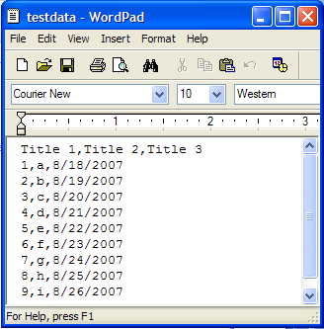
Reading CSV
import csv
import sys
f = open(r'E:\Python27\mindful_examples\csv\testdata.csv', 'r')
reader = csv.reader(f)
for row in reader:
print row
f.close()
========= RESTART: E:/Python27/mindful_examples/csv/testdata_read.py =========
['Title 1', 'Title 2', 'Title 3']
['1', 'a', '8/18/2007']
['2', 'b', '8/19/2007']
['3', 'c', '8/20/2007']
['4', 'd', '8/21/2007']
['5', 'e', '8/22/2007']
['6', 'f', '8/23/2007']
['7', 'g', '8/24/2007']
['8', 'h', '8/25/2007']
['9', 'i', '8/26/2007']

Slide 9
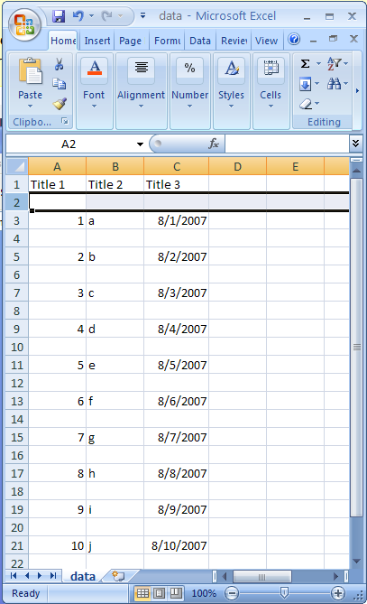
Writing CSV
import csv
import sys
f = open(r'E:\Python27\mindful_examples\csv\data.csv', 'wt')
writer = csv.writer(f, quoting=csv.QUOTE_NONNUMERIC)
writer.writerow( ('Title 1', 'Title 2', 'Title 3') )
for i in range(10):
writer.writerow( (i+1, chr(ord('a') + i), '08/%02d/07' % (i+1)) )
f.close()
print open(r'E:\Python27\mindful_examples\csv\data.csv', 'rt').read()
>>>
"Title 1","Title 2","Title 3"
1,"a","08/01/07"
2,"b","08/02/07"
3,"c","08/03/07"
4,"d","08/04/07"
5,"e","08/05/07"
6,"f","08/06/07"
7,"g","08/07/07"
8,"h","08/08/07"
9,"i","08/09/07"
10,"j","08/10/07"

Slide 10
Pickle
Text files are convenient because you can read and manipulate them with any text editor, but they’re limited to storing a series of characters.
Sometimes you may want to store more complex information, like a list or a dictionary, for example
Pickling means to preserve—and that’s just what it means in Python
You can pickle a complex piece of data, like a list or dictionary, and save it in its entirety to a file
The pickle module allows you to pickle and store more complex data in a file.

Slide 11
What Can Be Pickled and Unpickled?
The following types can be pickled:
None, True, and False
integers, long integers, floating point numbers, complex numbers
normal and Unicode strings
tuples, lists, sets, and dictionaries containing only picklable objects
functions defined at the top level of a module
built-in functions defined at the top level of a module
classes that are defined at the top level of a module
instances of such classes whose __dict__ or the result of calling __getstate__() is picklable

Slide 12
Shelve
The shelve module allows you to store and randomly access pickled objects in a file

Slide 13
Pickling and Shelving Functions
Function | Purpose
pickle.dump(obj, file_handle) | Write a pickled representation of obj to the open file object file
pickle.load(file) | Read a string from the open file object file and interpret it as a pickle data stream, reconstructing and returning the original object hierarchy
shelve.open(filename, flag='c', protocol=None, writeback=False) | Open a persistent dictionary. The filename specified is the base filename for the underlying database
Shelf.sync() | Write back all entries in the cache if the shelf was opened with writeback set to True
Shelf.close() | Synchronize and close the persistent dict object.
Refer:
https://docs.python.org/2/library/shelve.html
https://docs.python.org/2/library/pickle.html

Slide 14
Pickle: Example
# pickle_demo.py: Demonstrates pickling data
import pickle
print("Pickling lists")
variety = ["sweet", "hot", "dill"]
shape = ["whole", "spear", "chip"]
brand = ["Claussen", "Heinz", "Vlassic"]
f = open("pickles1.dat", "wb")
pickle.dump(variety, f)
pickle.dump(shape, f)
pickle.dump(brand, f)
f.close()
print("\nUnpickling lists")
f = open("pickles1.dat", "rb")
variety = pickle.load(f)
shape = pickle.load(f)
brand = pickle.load(f)
print(variety)
print(shape)
print(brand)
f.close()

Slide 15
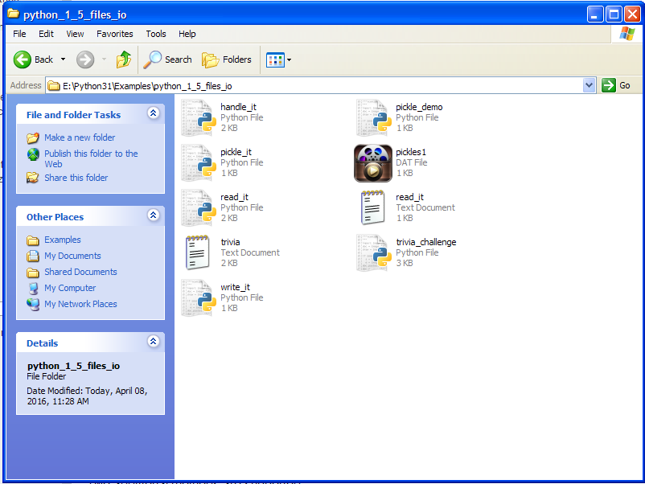
Output
>>>
Pickling lists
Unpickling lists
['sweet', 'hot', 'dill']
['whole', 'spear', 'chip']
['Claussen', 'Heinz', 'Vlassic']
pickles1.dat

Slide 16
Shelve: Example
# shelve_demo.py: Demonstrates shelving data
import shelve
print("\nShelving lists")
s = shelve.open("pickles2.dat")
s["variety"] = ["sweet", "hot", "dill"]
s["shape"] = ["whole", "spear", "chip"]
s["brand"] = ["Claussen", "Heinz", "Vlassic"]
s.sync() # make sure data is written
print("\nRetrieving lists from a shelved file:")
print("brand -", s["brand"])
print("shape -", s["shape"])
print("variety -", s["variety"])
s.close()
input("\n\nPress the enter key to exit.")

Slide 17
Output
>>>
Shelving lists
Retrieving lists from a shelved file:
brand - ['Claussen', 'Heinz', 'Vlassic']
shape - ['whole', 'spear', 'chip']
variety - ['sweet', 'hot', 'dill']
Press the enter key to exit.

Slide 18
The string format function
The format() method formats the specified value(s) and insert them inside the string's placeholder.
The placeholder is defined using curly brackets: {}. Read more about the placeholders in the Placeholder section below.
The format() method returns the formatted string.
Syntax
string.format(value1, value2...)

Slide 19
Case Study
Let’s check the code

Slide 20
Introduction
Internet happens to be the one of the primary application areas of Python programming language
Python standard library has wide support for network protocols, data encoding/decoding and other things you need to make it work
Writing network programs in Python tends to be substantially easier that C/C++
Notes:
Exercise: Google: Companies using python

Slide 21

The Challenge
Communication between computers
It’s just sending and receiving bits
But how?

Slide 22
Two Main Issues
Addressing
Specifying a remote computer and service
Data Transport
Moving bits back and forth

Slide 23

Network Addressing
Machines have a host name and IP address
Programs/services have port numbers
foo.bar.com
205.172.12.4
Network
www.python.org
82.94.237.218
Port 4521
Port 80

Slide 24
Standard Ports
Ports for common services are pre-assigned
21 FTP
22 SSH
23 Telnet
25 SMTP (Mail)
80 HTTP (Web)
110 POP3 (Mail)
119 NNTP (News)
443 HTTPS (web)
Other port numbers may just be randomly assigned to programs by the operating system

Slide 25
Client/Server Concept
Each endpoint is a running program
Servers wait for incoming connections and provide a service (e.g., web, mail, etc.)
Clients make connections to servers
Client
Server
www.python.org
82.94.237.218
Browser
Web
Port 80

Slide 26
Request/Response Cycle
Most network programs use a request/response model based on messages
Client sends a request message (e.g., HTTP)
GET /index.html HTTP/1.0
Server sends back a response message
HTTP/1.0 200 OK
Content-type: text/html
Content-length: 48823
<HTML>
...
The exact format depends on the application

Slide 27
Sockets
Script
socket
Programming abstraction for network code
Socket: A communication endpoint
Supported by socket library module
Allows connections to be made and data to be transmitted in either direction
Socket
Socket
Network

Slide 28
Socket Basics
To create a socket
socket.AF_INET Internet protocol (IPv4) 123.123.123.123
socket.AF_INET6 Internet protocol (IPv6) 1234.1234.1234.1234.1234.1234
Socket types
socket.SOCK_STREAM Connection based stream (TCP)
socket.SOCK_DGRAM Datagrams (UDP)
Example
from socket import *
s = socket(AF_INET, SOCK_STREAM)

Slide 29
Data (HTML, CSS, JS)(JSON)
HTTP
TCP
IP
Ethernet

Slide 30
Socket Types
Almost all code will use one of the following:
from socket import *
s = socket(AF_INET, SOCK_STREAM)
s = socket(AF_INET, SOCK_DGRAM)
Most common case: TCP Connection
s = socket(AF_INET, SOCK_STREAM)

Slide 31
Using a Socket
Creating a socket is only the first step
s = socket(AF_INET, SOCK_STREAM)
Further use depends on application
Server
Listen for incoming connections
Client
Make an outgoing connection
Data (HTML, CSS, JS)(JSON)
HTTP
TCP
IP
Ethernet
Script
Server
Script
Client
socket
socket
socket

Slide 32
TCP Client
How to make an outgoing connection
from socket import *
s = socket(AF_INET,SOCK_STREAM)
s.connect(("www.python.org",80)) # Connect
s.send("GET /index.html HTTP/1.0\n\n") # Send request
data = s.recv(10000) # Get response
s.close()
s.connect(addr) makes a connection
s.connect(("www.python.org",80))
Once connected, use send(), recv() to transmit and receive data
close() shuts down the connection

Slide 33
Server Implementation
Network servers are a bit more tricky
Must listen for incoming connections on an well-known port number
Typically run forever in a server-loop
May have to service multiple clients

Slide 34
TCP Server
A simple server
from socket import *
s = socket(AF_INET,SOCK_STREAM)
s.bind(("",9000))
s.listen(5)
while True:
c,a = s.accept()
print "Received connection from", a
c.send("Hello %s\n" % a[0])
c.close()
Send a message back to a client
% telnet localhost 9000
Connected to localhost.
Escape character is '^]'.
Hello 127.0.0.1
Connection closed by foreign host.
Server Message

Slide 35
TCP Server
Client socket and address
from socket import *
s = socket(AF_INET,SOCK_STREAM)
s.bind(("",9000))
s.listen(5)
while True:
c,a = s.accept()
print "Received connection from", a
c.send("Hello %s\n" % a[0])
c.close()
c,a = s.accept()
Accept returns a pair:
(client_socket, addr)
("104.23.11.4",27743)
This is a network /port address of the client that is connected
<socket._socketobject object at 0x3be30>
This is a new socket that is used for data

Slide 36
NON-OO APPROACH
Script
Server A
Script
Server B

Slide 37
OO APPROACH
Automation class
Script OBJ A
Server A
Script OBJ B
Server B

Slide 38
Flask – MVC Architecture
Server
Database
Templates
Model
View
Controller
Server
Component
WSGI
Socket
Client
Dev
FLASK

Slide 39
Testing
Dev
Tester

